Slide 1
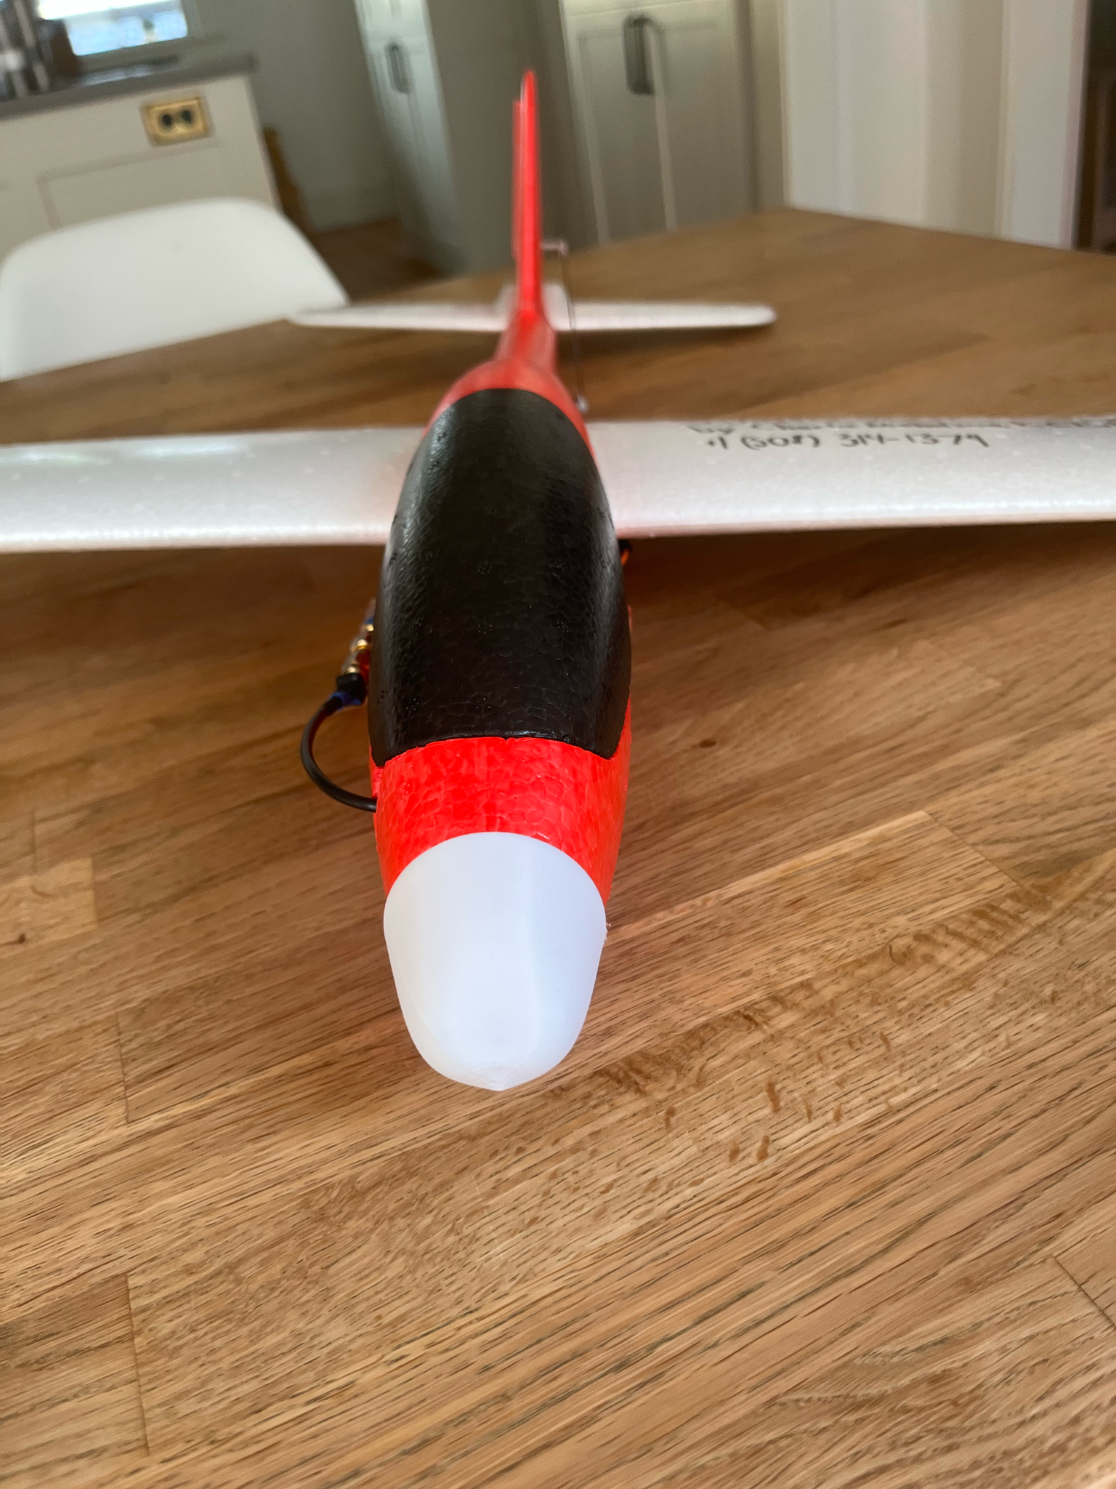
StratoSoar MK3.0
By Charlie Nicholson, KC1SFR

Slide 2
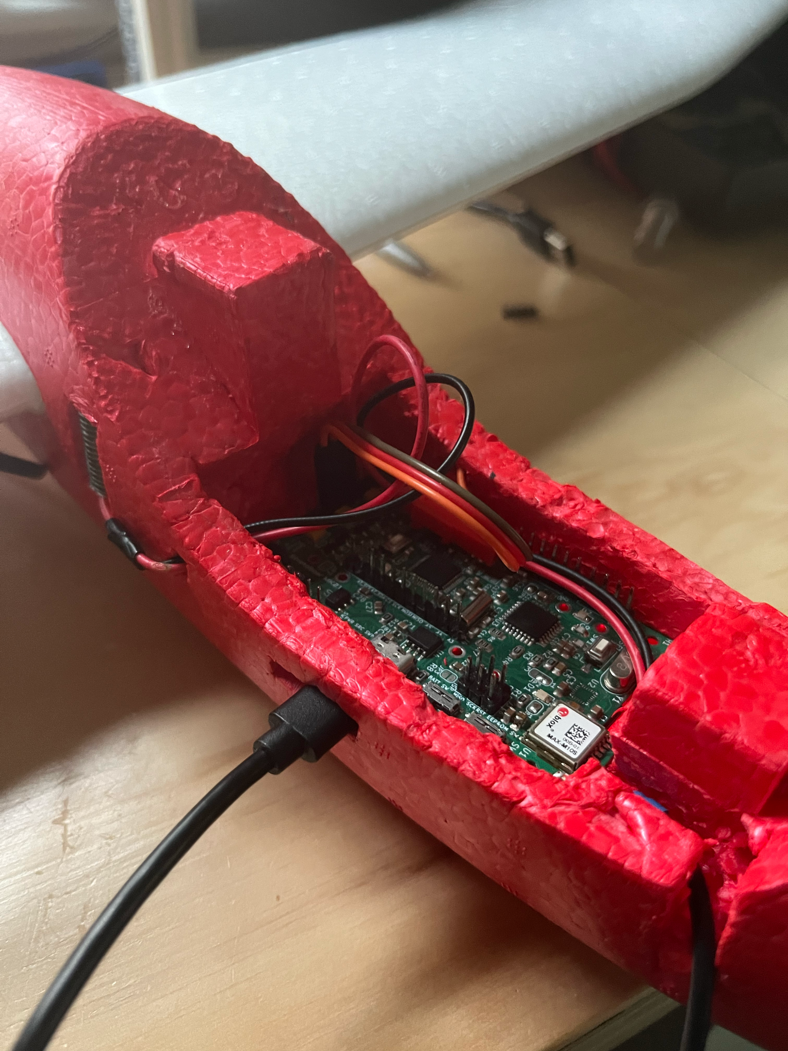
The Project
Radiosondes pollute everyday
They drop circuit boards, batteries and foam

Slide 3
The Solution
A glider that can steer home for reuse
Glider has same sensors that a radiosonde would have + more

Slide 4
What I Did
Autonomous glider
Custom flight computer PCB
Launch from 3,000 feet
Tiny4FSK tracking system

Slide 5
The Glider
Store bought foam glider
Cockpit rigged to hold custom PCB
Rudder modified for servo
Bay for tracker

Slide 6
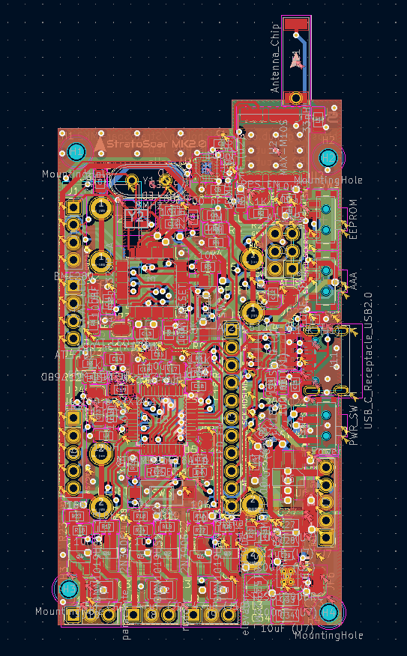
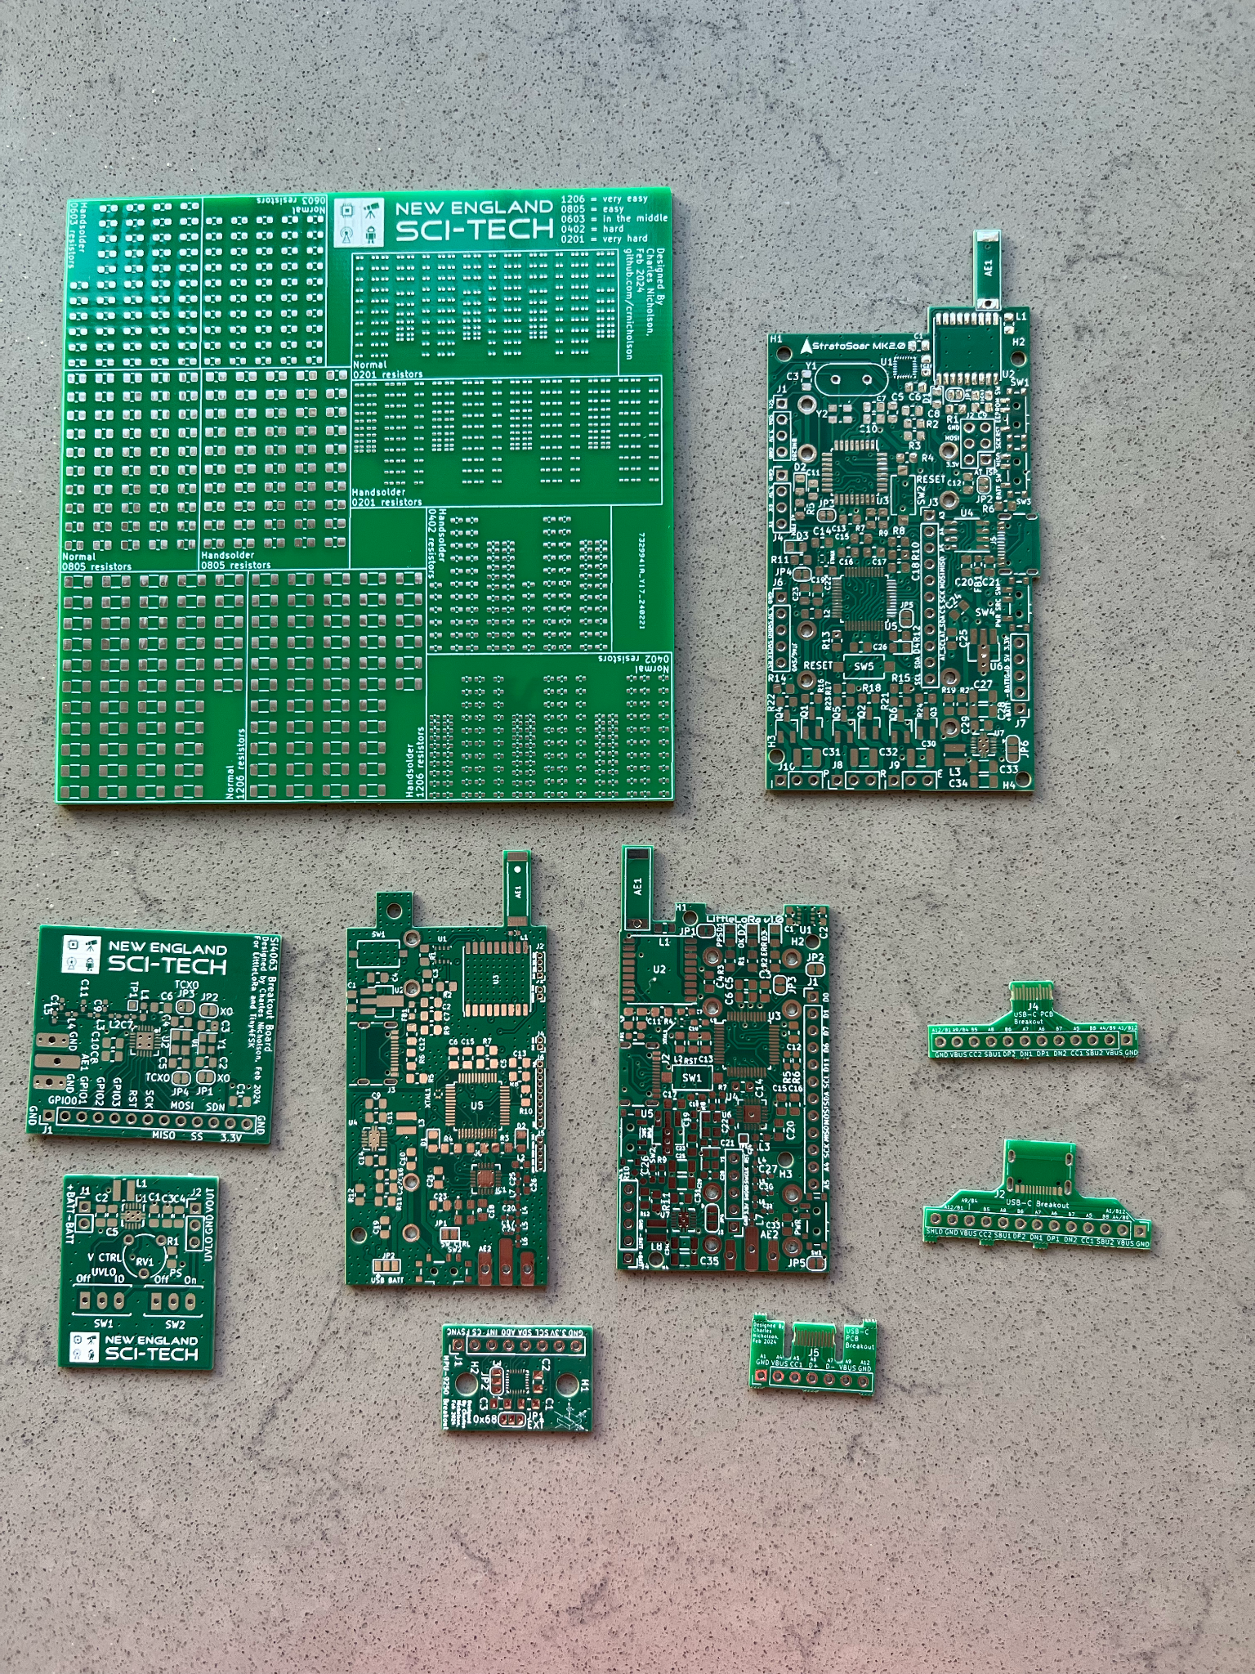
Electronics
Custom 4-layer PCB
150+ components
9 breakout boards
RF + power electronics
3 revisions

Slide 7
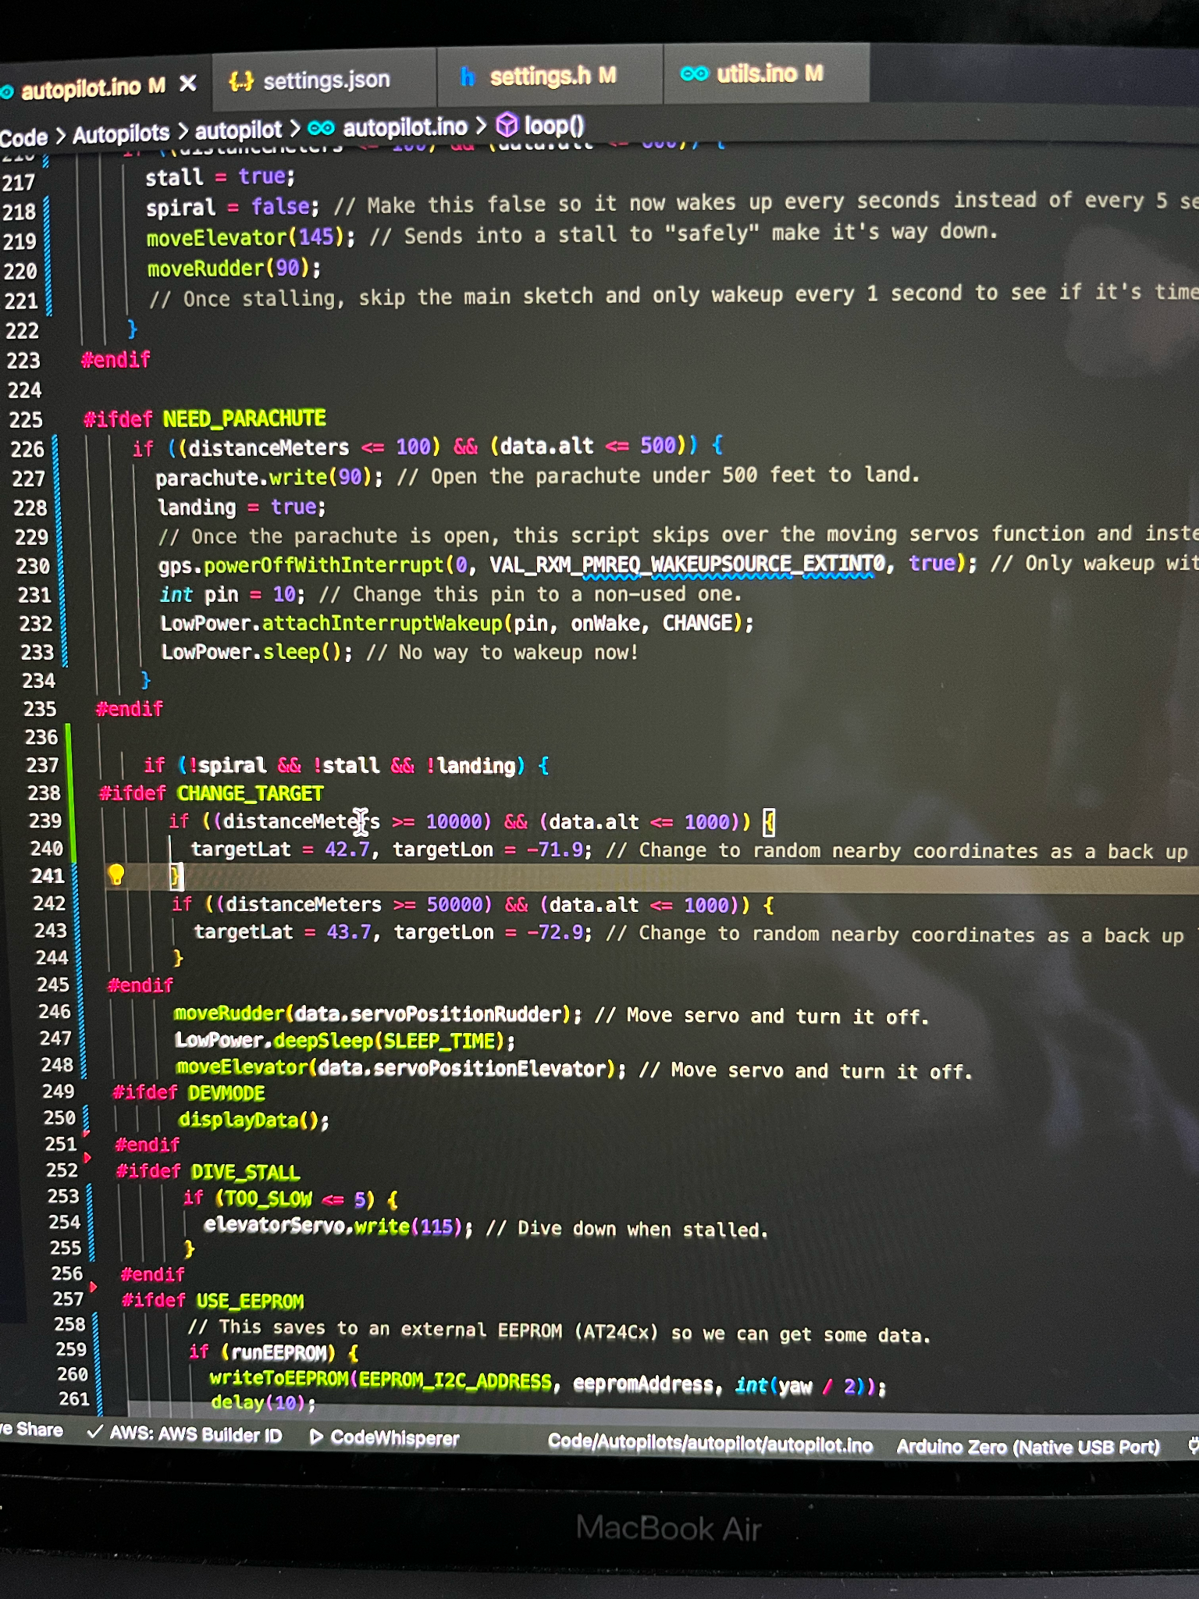
Code + Function
Arduino C++
IMU input w/ Kalman filter
PID algorithm
Low power modes

Slide 8
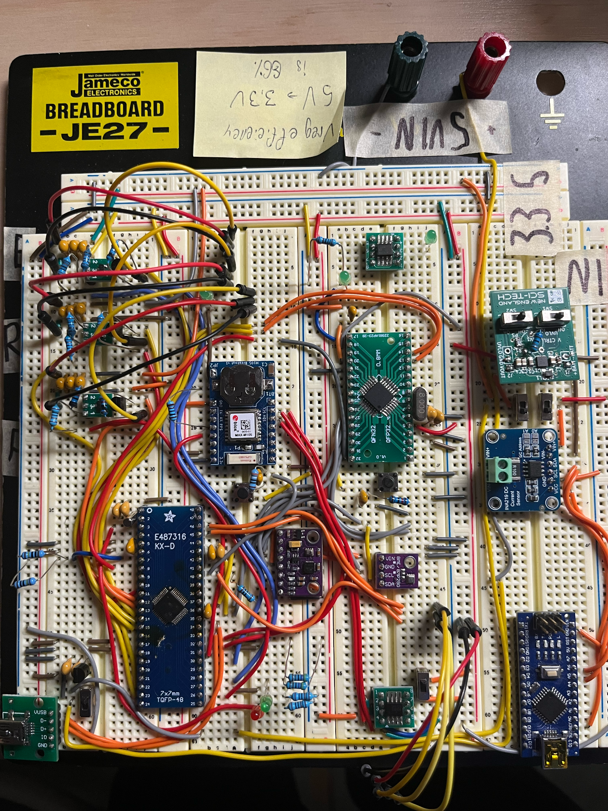
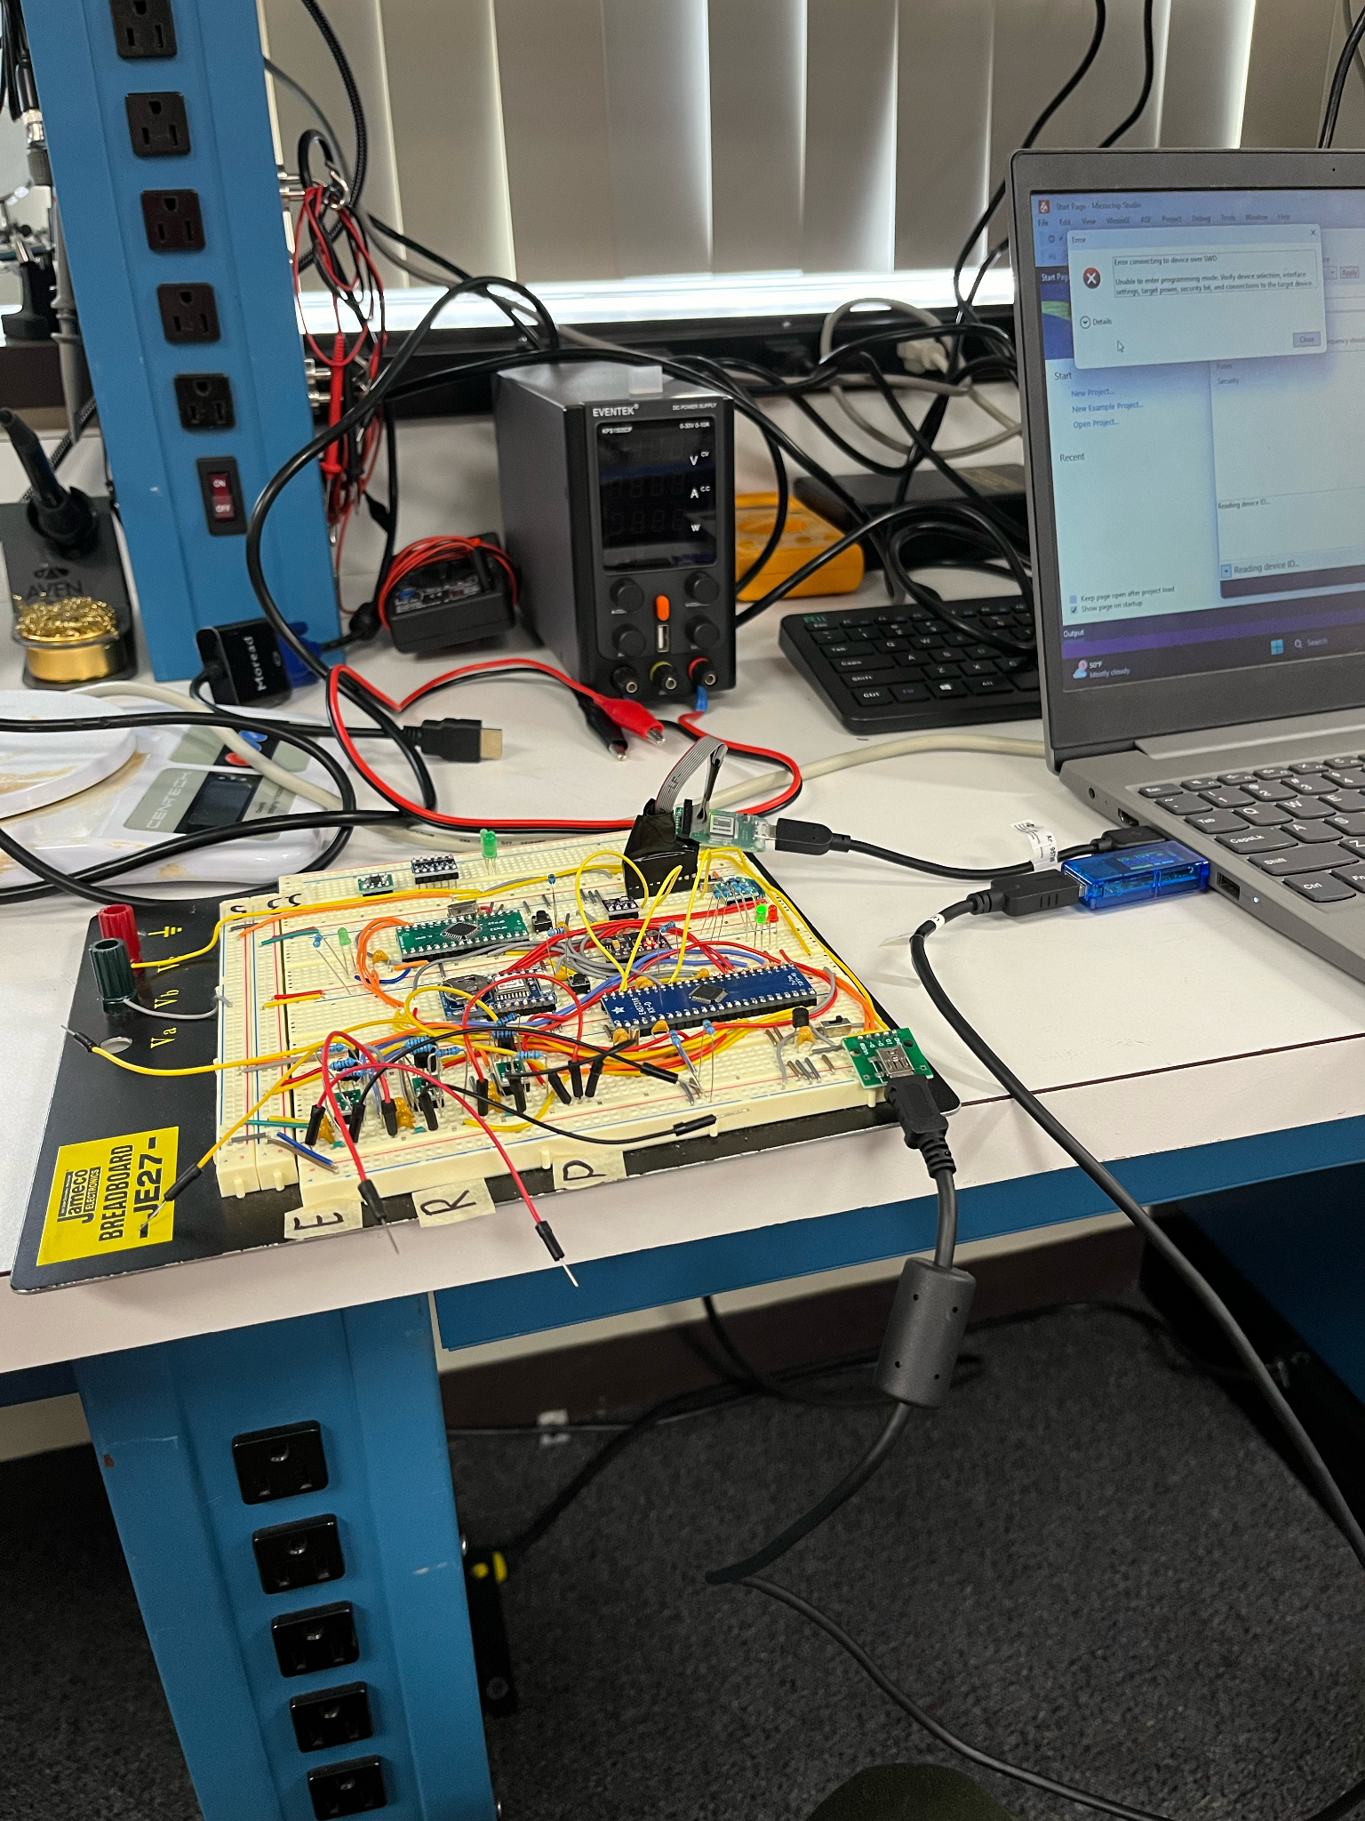
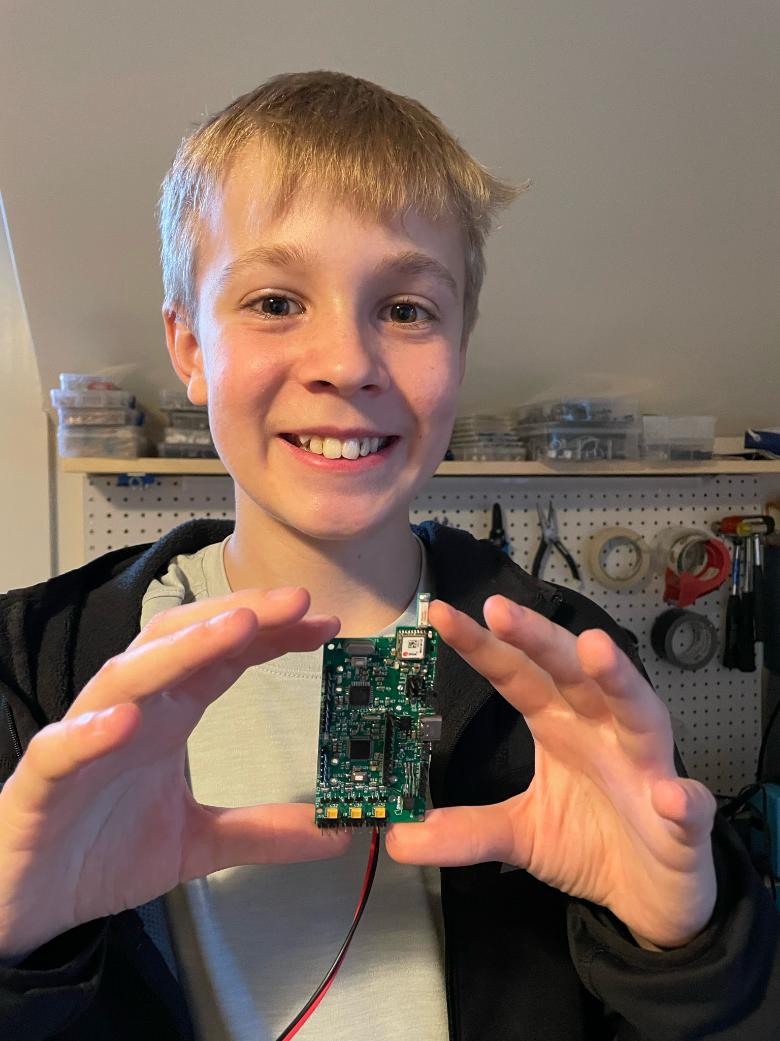
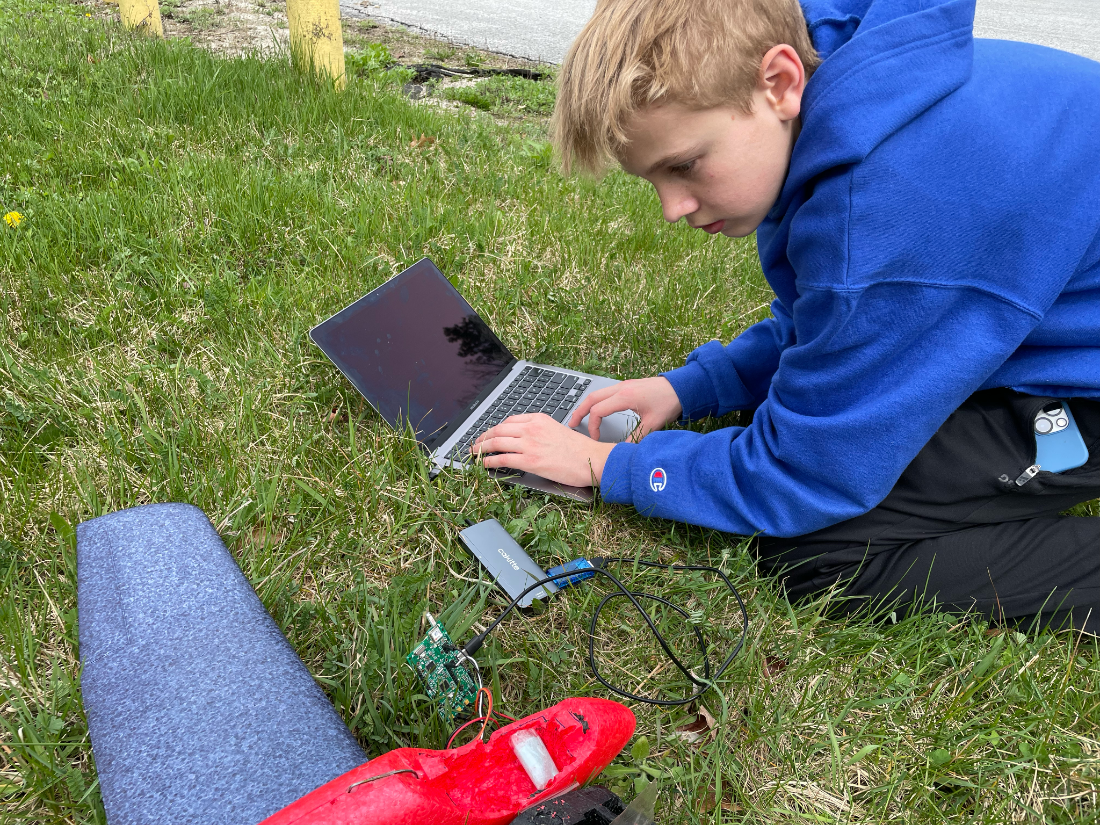
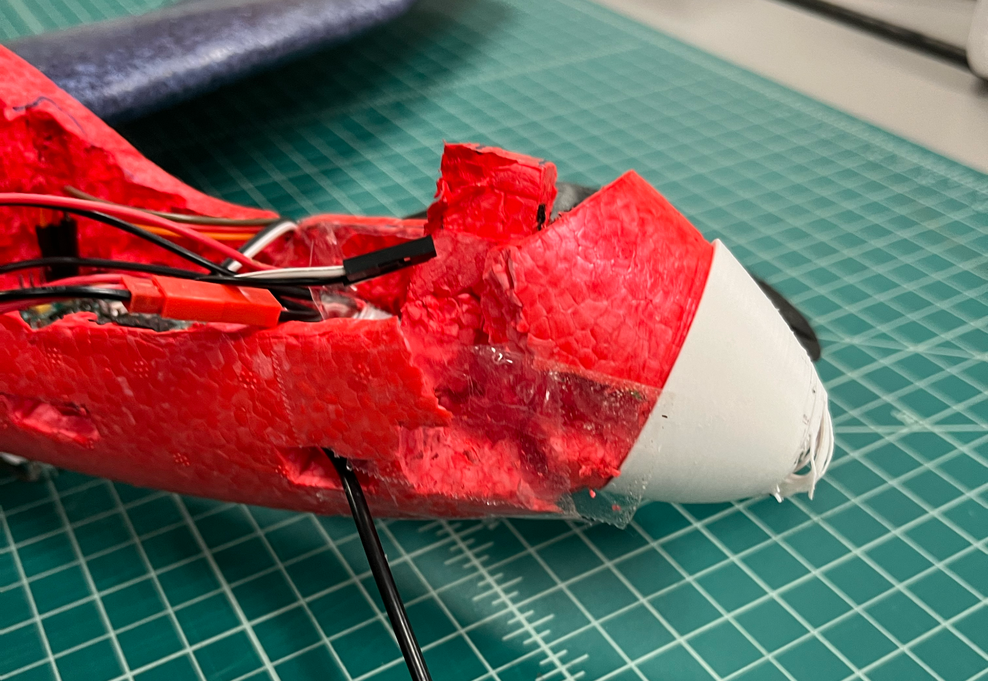
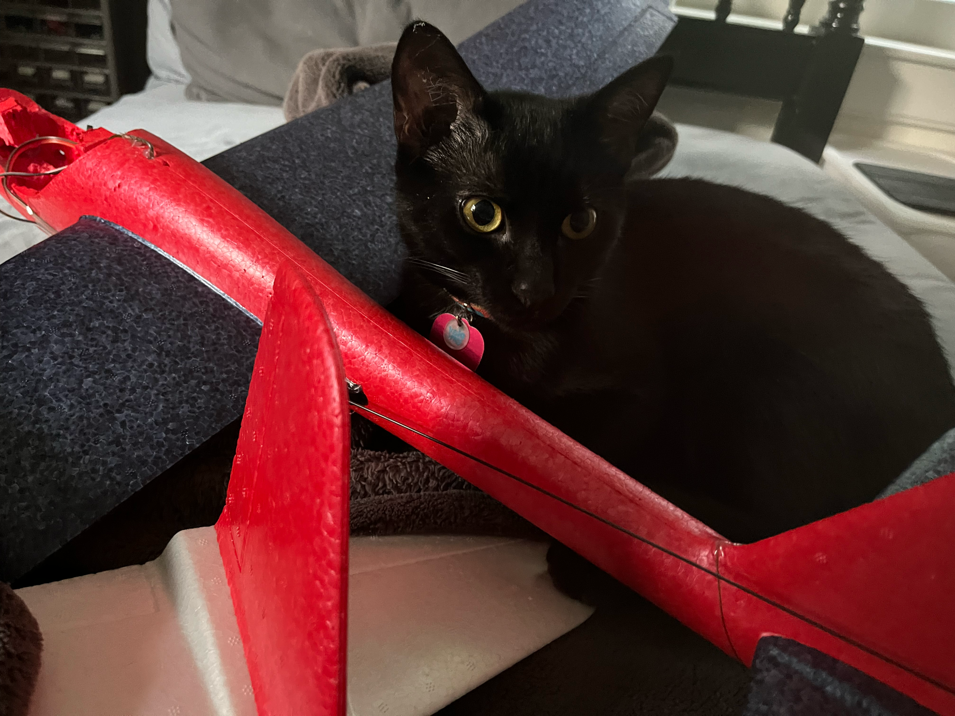
Photo Gallery
And for the next few slides!

Slide 9
Test Flights

Slide 10
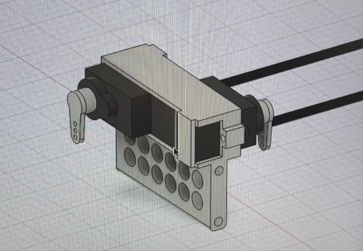
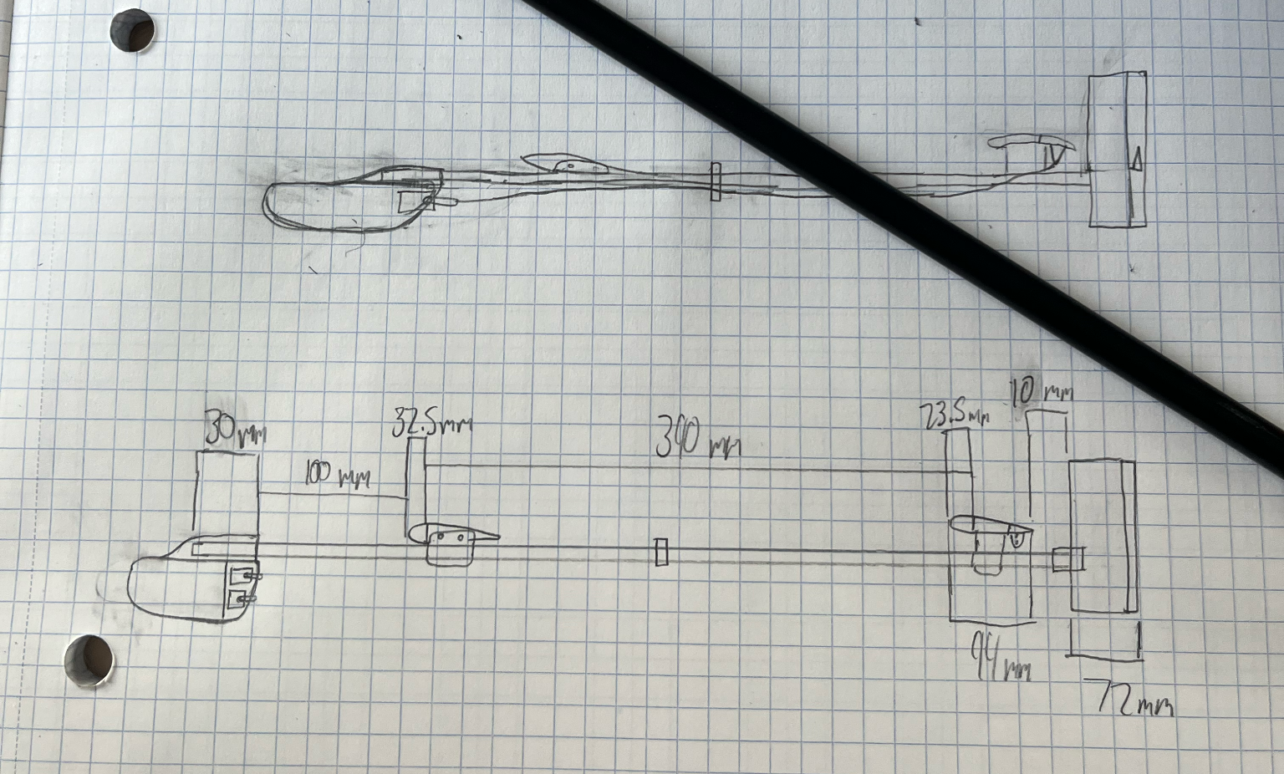
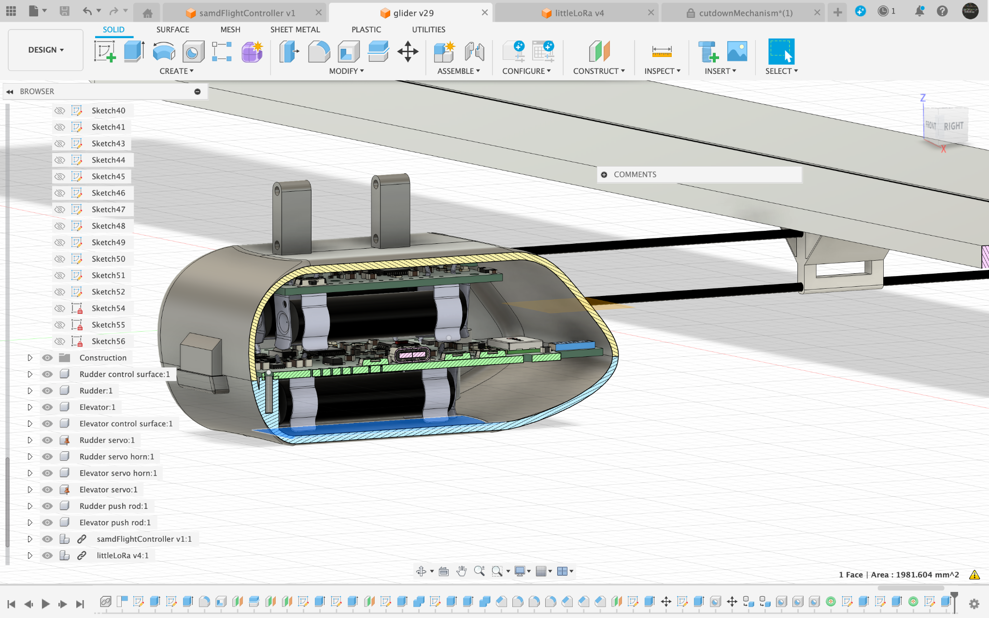
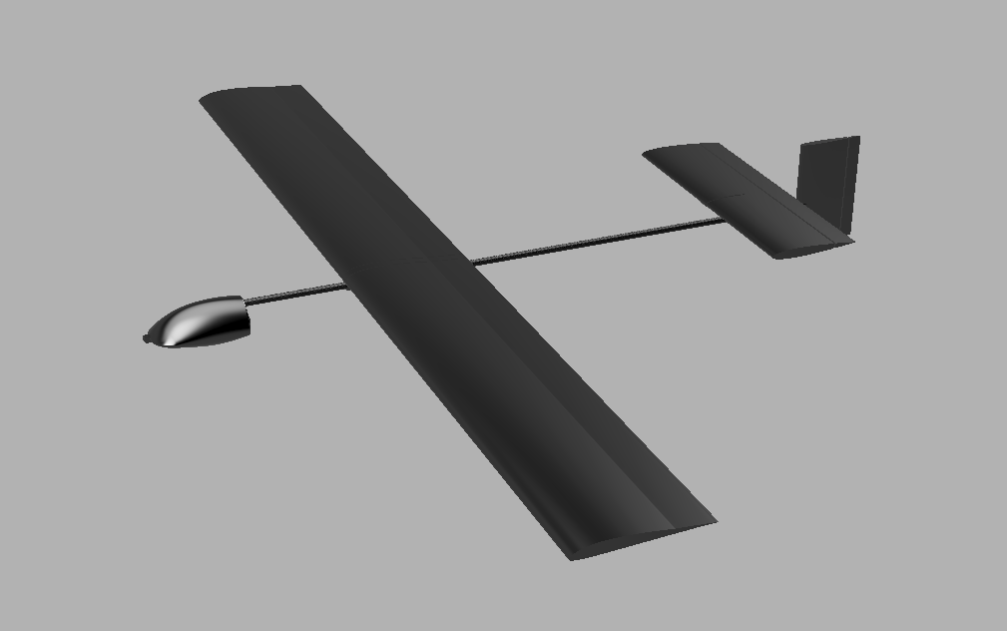
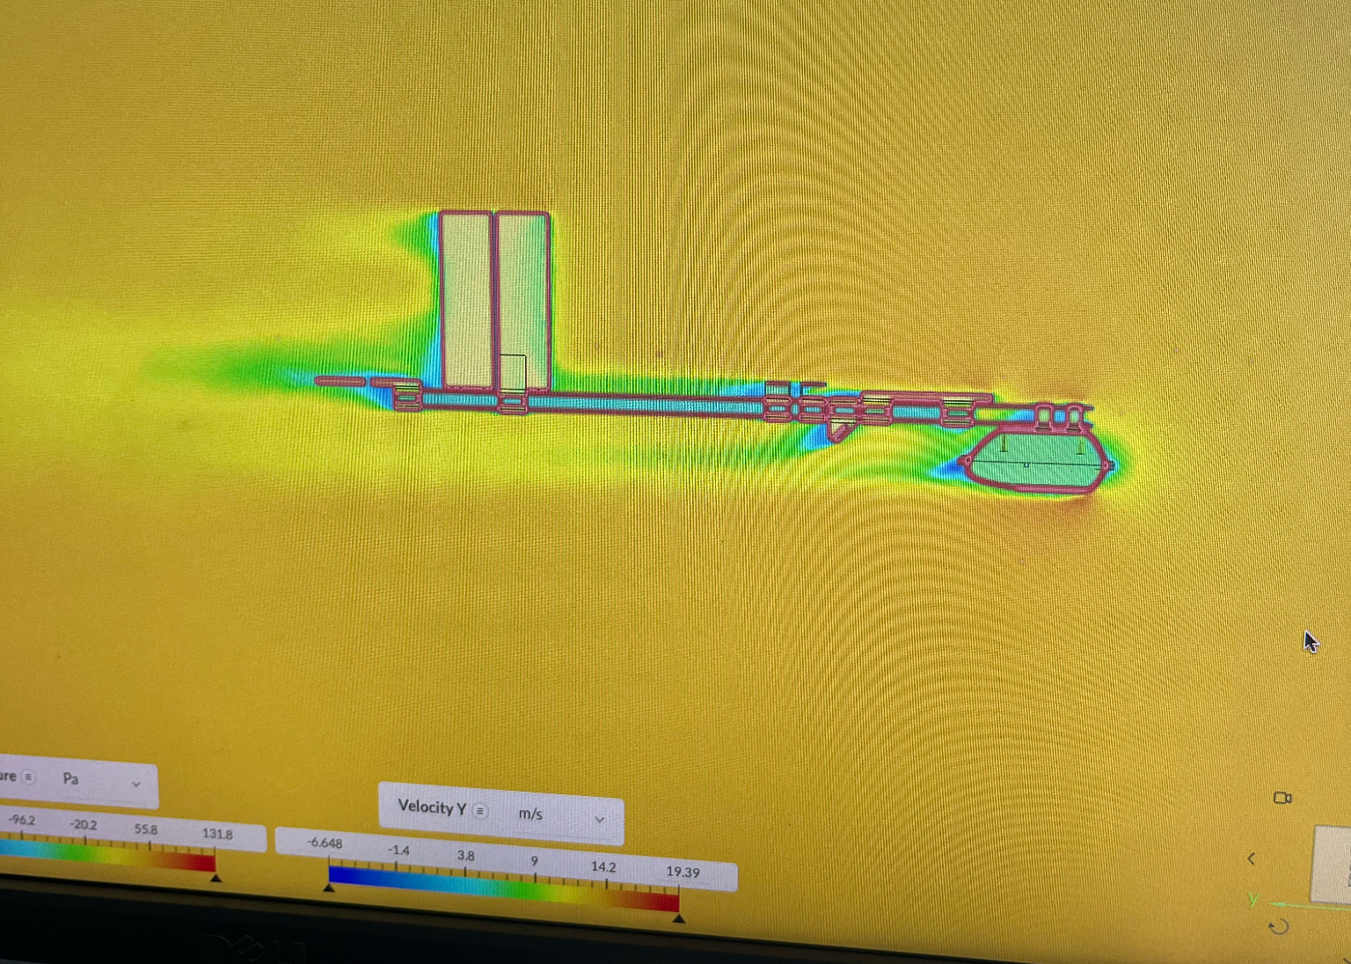
Next Steps
Custom flying wing glider
Smaller electronics
Integrated tracking

Slide 11
Want More?
Project page + GitHub: https://github.com/crnicholson/StratoSoar-MK2
Photos + videos: https://github.com/crnicholson/StratoSoar-MK2-Media
Email: charlienicholsonr@gmail.com

Slide 12

Legal Shmeegle
Glider is free flight glider
Loophole means little restrictions from FAA
However, tracker is not FCC approved

